Slide 1
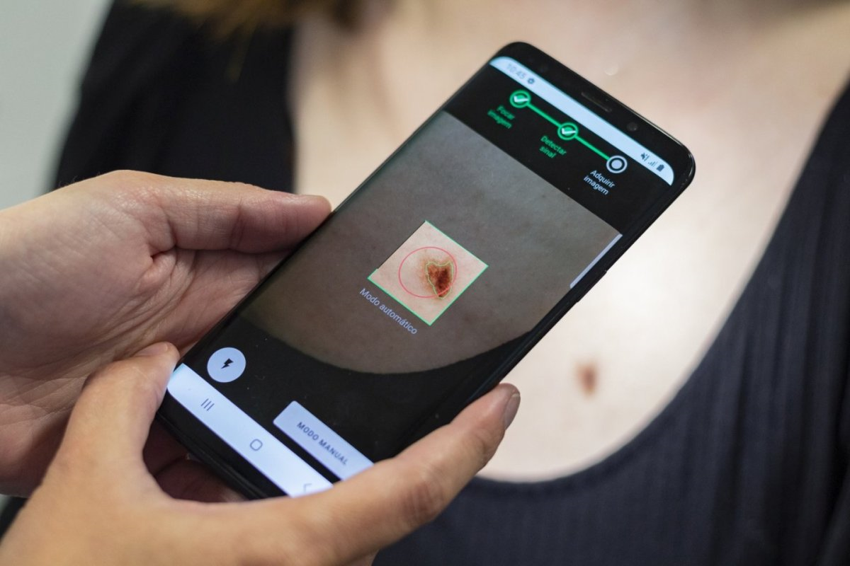
CANCER cell classification
USING IMAGE PROCESSING
Sachit girish samyuktha nagARAJ
1bi20ai040 1bi20ai041

Slide 2
Agenda
Introduction
Problem statement
Objectives
Literature review
Methodology
flowchart
conclusion
references

Slide 3
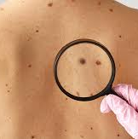
Introduction
SKIN CANCER DETECTION
Skin cancer, particularly malignant melanoma, is a deadly disease with late-stage diagnoses leading to limited treatment efficacy. Ignorance, improper home remedies, and delayed medical attention contribute to its severity
Dermoscopy, an observation-based technique, can aid in detecting melanoma, but accuracy depends on the dermatologist's expertise.
By leveraging image processing, computer systems can enhance diagnostic speed and accuracy by extracting detailed parameters such as asymmetry, color variation, and texture features that may elude human observation.

Slide 4
Problem statement
SKIN CANCER DETECTION
The aim of this study is to develop an effective system for the detection and classification of melanoma, a deadly form of skin cancer, using digital image processing techniques.
The goal is to leverage advanced image processing algorithms to analyze dermatoscopic images and accurately differentiate between benign and malignant skin lesions. By addressing the challenges of accurate detection and classification of melanoma, this project aims to improve early diagnosis and enhance the effectiveness of treatment interventions.
The proposed system will contribute to the field of dermatology by providing a reliable and non-invasive tool for dermatologists and healthcare professionals to assist in the early detection and accurate diagnosis of melanoma, ultimately leading to improved patient outcomes and reduced mortality rates.
4

Slide 5
objectives
SKIN CANCER DETECTION
The main objective of a Skin Cancer Detection Project using image processing is to detect the cancer.
To classify the same as if it is a melanoma or not.
To accurately prepare a system that takes the dermatoscopic image as input and gives the final result by applying various image processing and computer vision techniques and algorithms.
5

Slide 6
LITERATURE REVIEW
SKIN CANCER DETECTION
SL No. | Author Name & Year of Publication | Title Name & Journal Name | Abstract or Objectives | Techniques Used | Limitations
1 | Vijayalakshmi M M, 2019 | “Melanoma Skin Cancer Detection using Image Processing and Machine Learning”, International Journal of Trend in Scientific Research and Development (IJTSRD) 3.4 (2019): 780-784. | An automated system of dermatological disease recognition through lesion images. | Convolutional Neural Network (CNN), Support Vector Machine(SVM). | The paper does not provide any information on the robustness of the system in real-world scenarios where these factors can vary widely
2 | Jain, Shivangi, and Nitin Pise, 2015 | "Computer aided melanoma skin cancer detection using image processing.“, Procedia Computer Science 48 (2015): 735-740. | Extracting Color and Texture features to derive information about the skin lesion, such as variations in hue, saturation, and brightness. | Otsu’s Thresholding in 3 separate planes - Red, Green and Blue | Performance on images with different lighting conditions, skin tones, and camera settings.
6

Slide 7
LITERATURE REVIEW
SKIN CANCER DETECTION
SL No. | Author Name & Year of Publication | Title Name & Journal Name | Abstract or Objectives | Techniques Used | Limitations
3 | Premaladha, J., et al., 2014 | "A survey on melanoma diagnosis using image processing and soft computing techniques.“, Research Journal of Information Technology 6.2 (2014): 65-80. | An automated system of dermatological disease recognition through lesion images. | Convolutional Neural Network (CNN), Support Vector Machine(SVM). | The paper does not provide any information on the robustness of the system in real-world scenarios where these factors can vary widely
4 | Jain, Shivangi, and Nitin Pise, 2015 | "Computer aided melanoma skin cancer detection using image processing.“, Procedia Computer Science 48 (2015): 735-740. | A comprehensive review of different methodologies to diagnose melanoma, a deadly skin cancer. | Gaussian filtering, Region Merging, Decision Tree | The paper concludes that no single technique is suitable for all types of images, and the choice of technique depends on the specific application.
7

Slide 8
LITERATURE REVIEW
SKIN CANCER DETECTION
SL No. | Author Name & Year of Publication | Title Name & Journal Name | Abstract or Objectives | Techniques Used | Limitations
5 | Garg, Nishtha, Vishakha Sharma, and Prabhjot Kaur, 2018 | "Melanoma skin cancer detection using image processing.“, Sensors and Image Processing: Proceedings of CSI 2015 (2018): 111-119. | Studies of skin cancer detection using fuzzy clustering with machine learning methods and wavelet analysis is tested with 50 sample images | K-Nearest Neighbor Neural Network (KNN), Support Vector Machine (SVM). | The robustness of the system in real-world scenarios where factors like lighting conditions, skin tones, and camera settings vary widely.
6 | Goyal, Puneet Kumar, and Mradul Kumar Jain, 2018 | "Computer-aided diagnosis of melanoma skin cancer: a review.“, Advances in Data and Information Sciences: Proceedings of ICDIS-2017, Volume 1 (2018): 63-73. | A comparative study of various phases of computer-aided melanoma skin cancer detection system | Artificial Neural Network (ANN) | One of the first studies conducted in the Indian context with regards to new age technologies.
8

Slide 9
LITERATURE REVIEW
SKIN CANCER DETECTION
SL No. | Author Name & Year of Publication | Title Name & Journal Name | Abstract or Objectives | Techniques Used | Limitations
7 | Victor, Akila, and M. Ghalib, 2017 | "Automatic detection and classification of skin cancer.“, International Journal of Intelligent Engineering and Systems 10.3 (2017): 444-451. | An automated system of dermatological disease recognition through lesion images. | Convolutional Neural Network (CNN), Support Vector Machine(SVM). | The paper does not provide any information on the robustness of the system in real-world scenarios where these factors can vary widely
9

Slide 10

Methodology
Pre-processing
segmentation
Feature
extraction
Post-processing
classification
Hair removal
Shading removal
Glare removal
Contrast Enhancement
Identify the region of necessity
Identify features using statistical methods
Determine specific features
Use the ABCDE rules

Slide 11
Image acquisition
SKIN CANCER DETECTION
The images were collected from the ISIC dataset
ISIC stands for International Skin Imaging Collaboration
The ISIC dataset provide the collection of images for melanoma skin cancer.
This ISIC dataset contains approximately 23,000 images of which we have collected 1000-1500 images and trained and tested over these images.
11

Slide 12
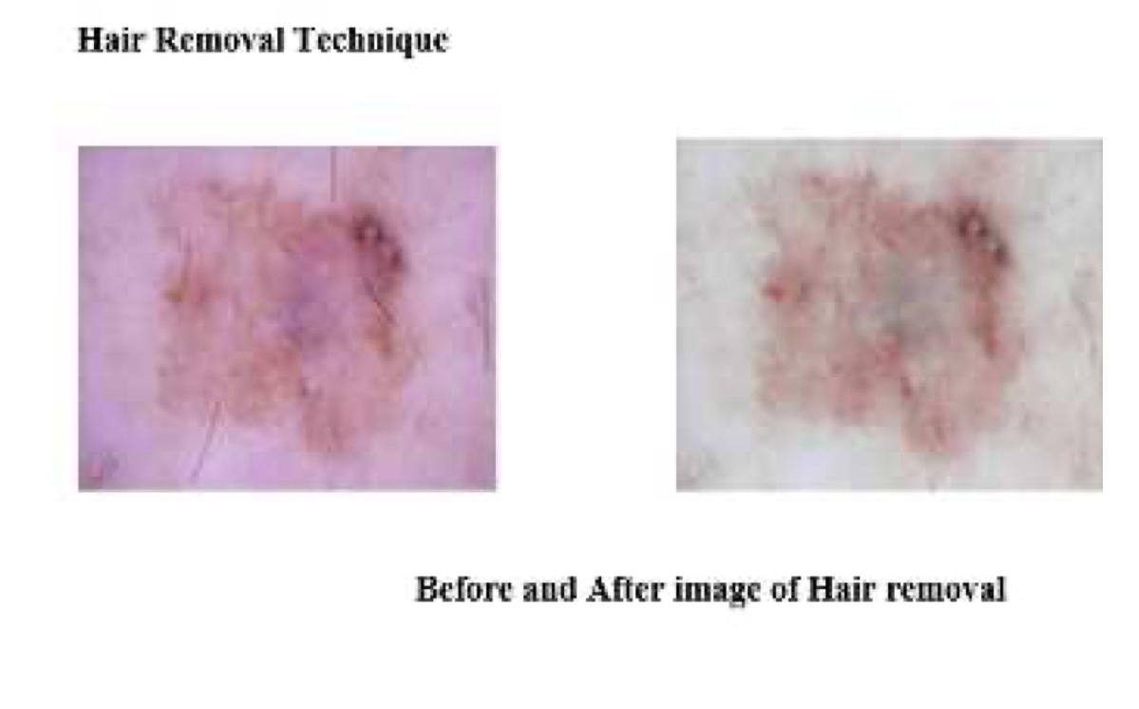
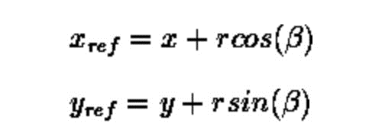
Pre-processing
SKIN CANCER DETECTION
Hair removal:
For the collected images hair removal method was applied this method was performed using Hough transform, Hough transform is basically used to identify lines or elliptical or circular shapes. The equations are given as,
12

Slide 13
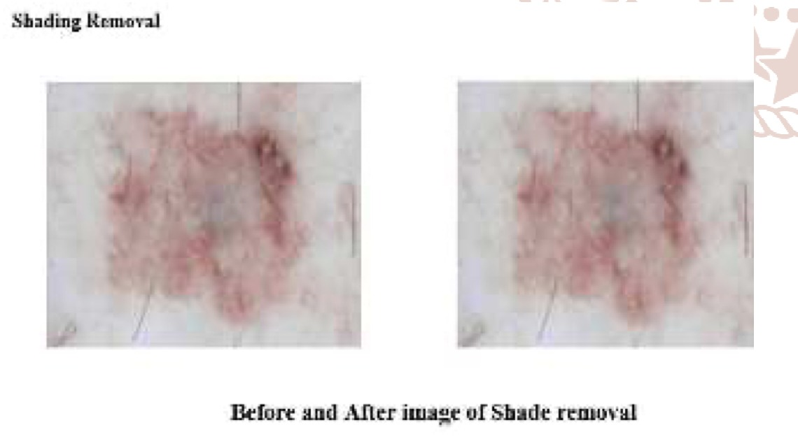
Pre-processing
SKIN CANCER DETECTION
2. Shading removal:
Using MATLAB filters, the few light and dark shade around the region of the tumor are removed, which provides us a clear vision of the tumor which is also helpful in the further enhancements.
3. Contrast enhancement:
Involves changing the original values so that more of the available range is used, thereby increasing the contrast between targets and their backgrounds
13

Slide 14
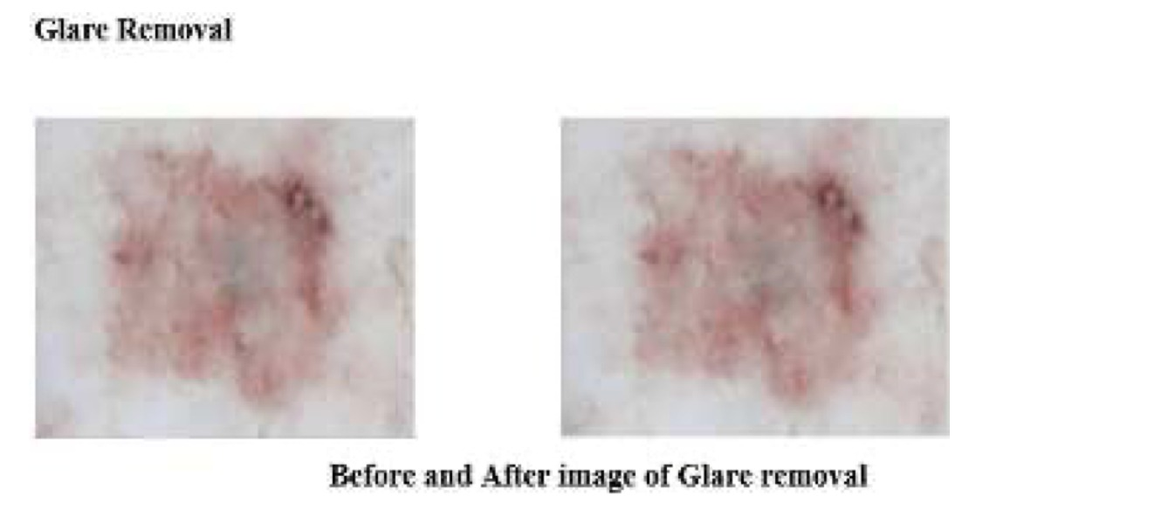
Pre-processing
SKIN CANCER DETECTION
4. Glare Removal:
Sometime the images are captured from camera the images will contain glare this glare is not visible to the naked eyes, we remove this glare using the MATLAB filter, this minute noise sometimes may affect the accuracy at the end.
14

Slide 15

segmentation
SKIN CANCER DETECTION
The segmentation phase helps to identify the region of necessity and hence Otsu’s thresholding is done here.
Otshu explains with both the background and the foreground image by means of the histogram that is calculated considering 0 to 7 intensity level calculations and assumes for 7 total values with the formula given below,
The algorithm helps us to find the background and foreground pixels in an image and equate to the number of pixels found against the total no of background and foreground pixels. Then the mean and the variance of the corresponding foreground and the background is estimated.
15

Slide 16
feature extraction
SKIN CANCER DETECTION
The feature extraction is the third important step of the detection.
The features have to be selected, the corresponding feature that is selected in our work are area, mean, variance and standard deviation.
The features are very important as of classification is concerned and the feature extraction helps in the detection as well.
There are various feature extraction methodology the GLCM, Gabor filter etc. We use the basic statistical method and in future we would try to take more number of features to further improve the classification accuracy.
16

Slide 17
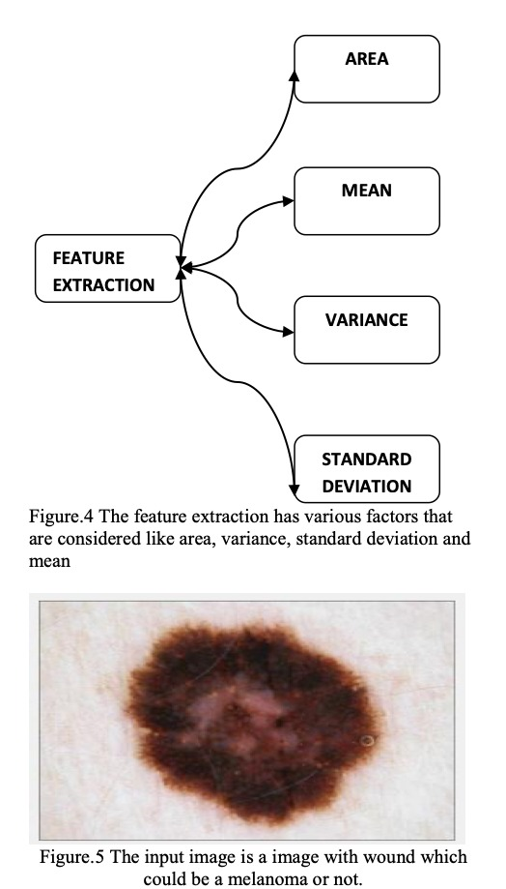
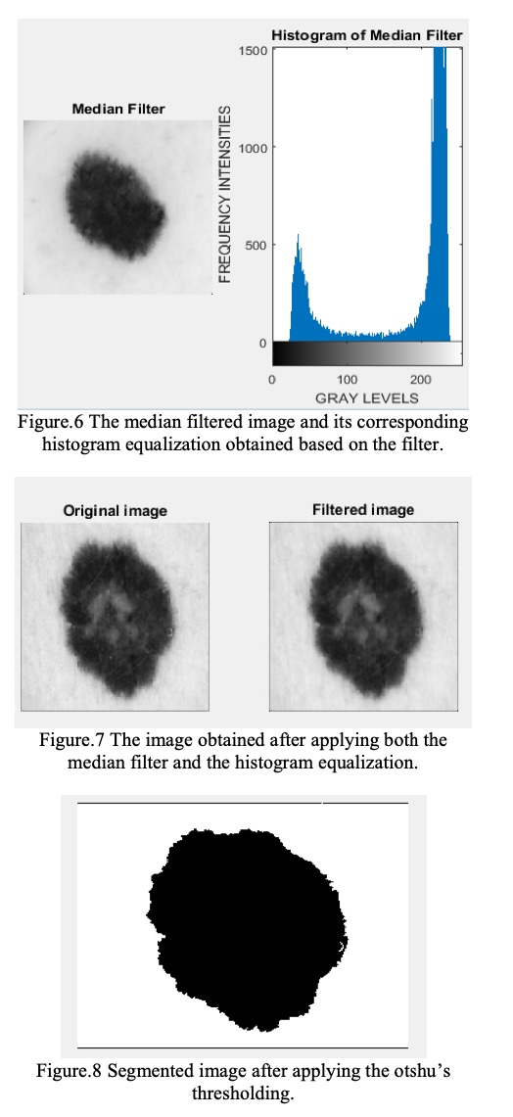
feature extraction
SKIN CANCER DETECTION
17

Slide 18
Post-processing
SKIN CANCER DETECTION
Post processing is a technique done after the features are extracted from the melanoma skin lesion.
The mean value of R, G and B corresponding to the pixels is computed from the corners of the 20×20 pixels image.
The background skin color is estimated with the help of this mean color. The portions that come under light colored category, that is, portions with less than 60 mean colored distances to that of non-lesion skin color are discarded.
Added rectangular bordered regions and those that touch the image frame are removed.
18

Slide 19
Post-processing
SKIN CANCER DETECTION
Initially, result for border detection is acquired by merging the left out regions after eliminating the regions that are isolated.
The following iterative expression is used for extraction purpose:
X = (X. XOR B)intersection A (20)
The algorithm converges when X, = X,., and let Y= X., The implementation of the algorithm takes place in recursive manner and the segmented image pixel is taken as input. If the surrounding pixel and latter have the same value, then it is given as input.
Two regions are produced by segmentation procedure: Lesion and background skin. These regions are partitioned into multiple sub regions by segmentation procedure because they are rarely homogeneous.
19

Slide 20
classification
SKIN CANCER DETECTION
The Feature Values Extracted in the Feature Extraction stage are compared and the skin lesion is classified as Melanoma Skin Cancer or normal skin or Mole.
Using the ABCDE rules for the melanoma skin cancer, we use some predefined thresholds in classification stage. The ABCDE rules are defined as follows:
Asymmetry (A): Generally the normal moles are symmetric and the skin cancer moles are asymmetric
Border (B): Melanocytic lesions are usually found with blurry or jagged edges
Color (C): Different colors are found inside the mole of the melanotic lesion
Diameter (D): Normal diameter of the lesion is around 6 mm, which becomes suspicious when extended
Elevation (E): It is suspicious when the mole is found in elevated form
20

Slide 21
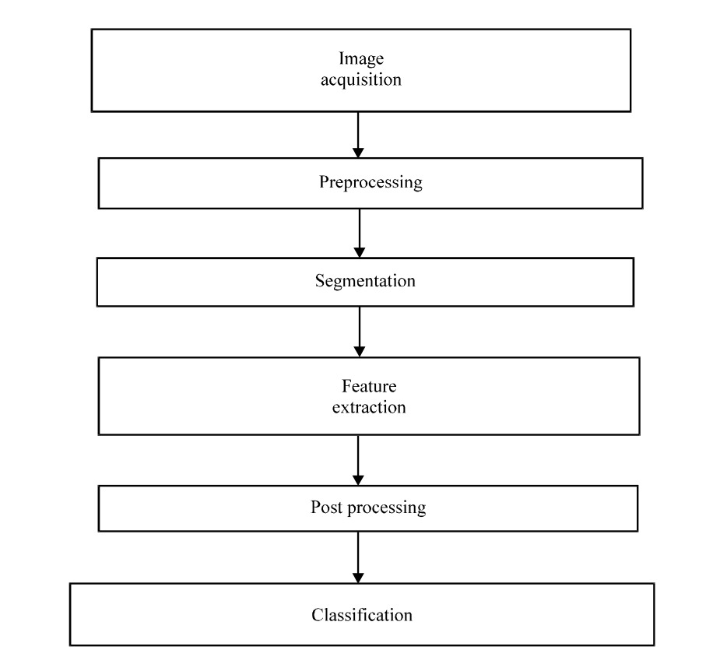
flowchart
SKIN CANCER DETECTION
21

Slide 22

conclusion
SKIN CANCER DETECTION
This study discusses methodologies for accurate melanoma diagnosis. Preprocessing, segmentation, feature extraction, post-processing, and classification stages are employed. The combination of median filtering/Gaussian filter, iterative segmentation, color-based feature selection, island removal, and decision tree classifier yields the best results for early melanoma detection.
22

Slide 23
references
SKIN CANCER DETECTION
"Melanoma skin cancer detection using image processing and machine learning." Vijayalakshmi, M. M. International Journal of Trend in Scientific Research and Development (IJTSRD) 3.4 (2019): 780-784.
"Computer-aided diagnosis of melanoma skin cancer: a review." Goyal, Puneet Kumar, and Mradul Kumar Jain. Advances in Data and Information Sciences: Proceedings of ICDIS-2017, Volume 1 (2018): 63-73.
"A survey on melanoma diagnosis using image processing and soft computing techniques." Premaladha, J., et al. Research Journal of Information Technology 6.2 (2014): 65-80.
23

Slide 24
references
SKIN CANCER DETECTION
"Melanoma skin cancer detection using image processing." Garg, Nishtha, Vishakha Sharma, and Prabhjot Kaur. Sensors and Image Processing: Proceedings of CSI 2015 (2018): 111-119.
"Automatic detection and classification of skin cancer." Victor, Akila, and M. Ghalib. International Journal of Intelligent Engineering and Systems 10.3 (2017): 444-451.
"Computer aided melanoma skin cancer detection using image processing." Jain, Shivangi, and Nitin Pise. Procedia Computer Science 48 (2015): 735-740.
24

Slide 25

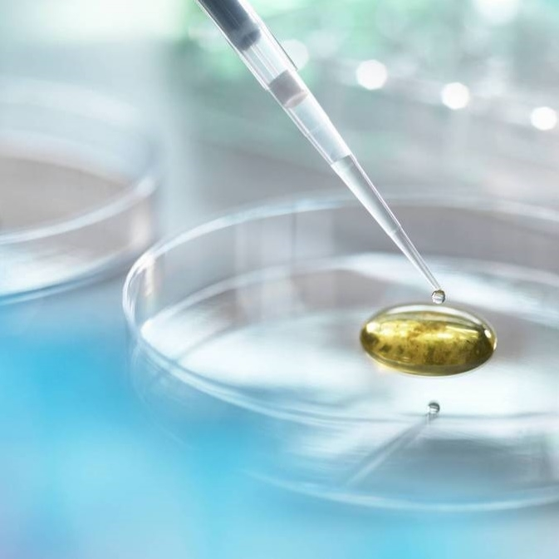
Thank you
Sachit girish sAMYUKTHA NaGARAJ

